Slide 1

The Public Sector Equality and Human Rights Duty
Presentation to CWI / AIEB Continuous Practice Development Workshop
^{Jacqueline Healy}
^{Public Sector Duty Manager}

Slide 2
The Public Sector Equality
and Human Rights Duty
Section 42 Irish Human Rights and Equality Commission Act 2014

Slide 3

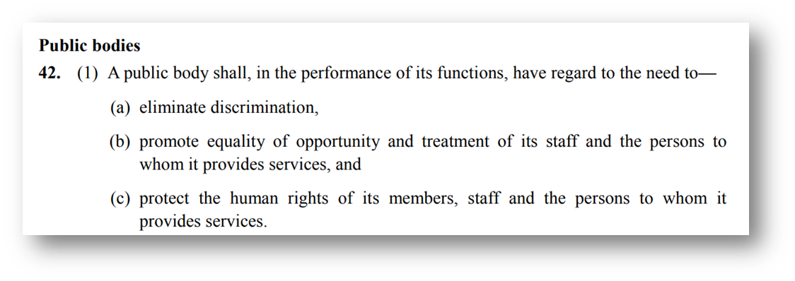
What is the Public Sector Equality and Human Rights Duty?
S42 of the Irish Human Rights and Equality Commission Act 2014

Slide 4



What do Public Sector Bodies have to do?
In summary, S42(2) of the IHREC Act 2014 requires a public body:
1. To assess
Set out in its strategic plan an assessment of the human rights and equality issues it believes to be relevant to the functions and purpose of the body, in a manner that is accessible to the public.
2. To address
Set out in its strategic plan the policies, plans and actions in place or proposed to be put in place to address those issues, in a manner that is accessible to the public.
3. To report
Report on developments and achievements in relation to 1 and 2 above in its annual report, in a manner that is accessible to the public.

Slide 5
Why is it important?
It is the State’s responsibility to:
respect, protect and fulfil human rights, in line with its international commitments.
to be proactive in ensuring that all public bodies are human rights and equality compliant.
The Duty, as a catalyst for institutional reform, can play a significant role here.
It can improve public services, addressing issues such as accessibility, so that they meet the needs of everyone who requires them
It can improve work places - the human rights and equality needs of staff are respected.

Slide 6
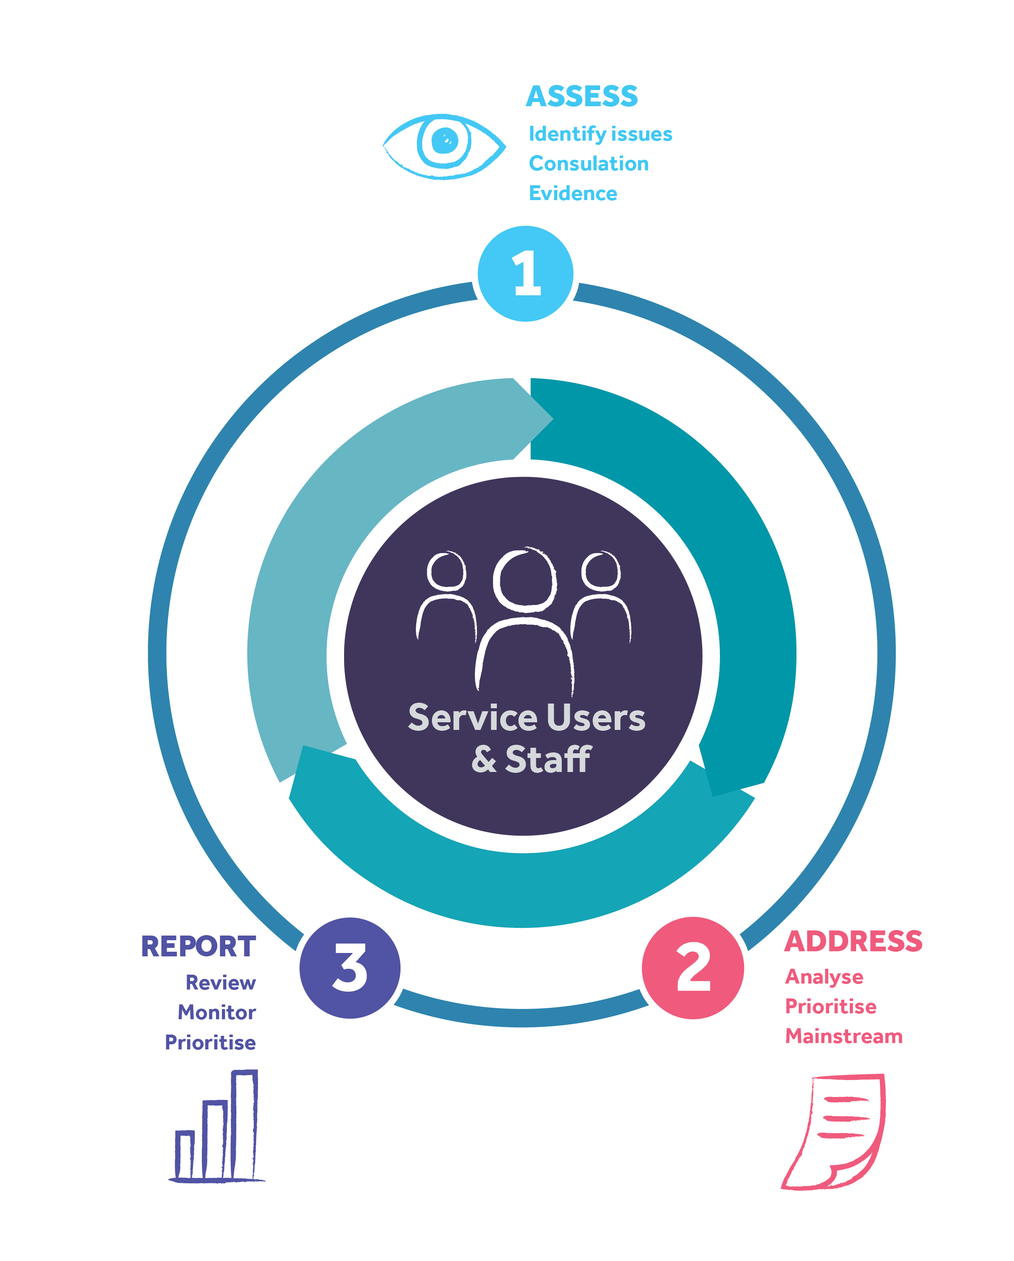
The Strategic Planning Cycle
The Duty is an ongoing obligation on public bodies, which must be incorporated as part of an organisation’s overall strategic planning cycle.
42(2)(a) of the IHREC Act 2014 requires an organisation to set out in its strategic plan “an assessment of the human rights and equality issues it believes to be relevant to the functions and purpose of the body and the policies, plans and actions in place or proposed to be put in place to address those issues”.

Slide 7
Across the Functions
The Duty applies across the functions of the organisation
Organisational Planning / Corporate Services (strategic planning, budget allocation, procurement, grant funding)
Human Resources (recruitment, HR policies and practices, staff capacity building)
Service Provision (delivery of a service or engagement with key stakeholders)
Research and Policy
Regulatory & Oversight

Slide 8

Guidance for Public Bodies

Slide 10

Step 1: Assess
Take Action
Stages for conducting a Human Rights and Equality Assessment
There are three stages to consider when undertaking the Human Rights and
Equality Assessment.
It involves:
Identifying human rights and equality issues
Identifying structures and initiatives in place to support human rights and equality
Prioritising areas for action
Inform the Strategic Cycle (planning implementation evaluation)

Slide 11
Focus of the Assessment
People covered by the nine grounds under equality legislation: gender (including a transgender person or a person who is transitioning to another gender), civil status, family status (including lone parents and carers), age, sexual orientation, disability, race, religion, and membership of the Traveller community;
Human rights that pertain to the purpose and function of a public body – a focus on people at risk of poverty and social exclusion can come under this lens
Intersectionality: Important to note that many people experience multiple forms of discrimination.

Slide 12
Evidence Based Assessment
Consultation with staff and service users
Data from Central Statistics Office
Reports and research from Economic and Social Research Institute (ESRI) and the Commission
Cases taken to Workplace Relations Commission under employment equality and equal status legislation
Civil society organisations reports / submissions

Slide 13
Consultation and the role of Civil Society in supporting implementation of the Public Sector Duty

Slide 14
Consultative Approach
Key messages to public bodies:
Consult with service users and staff at each of the three stages of Assess, Address and Report in a timely way – strategic planning cycle
Inclusive consultation with all identified groups – nine grounds and persons at risk of poverty and social exclusion
Invite groups to give feedback on draft assessment, draft action plan and the draft report on progress and achievements – evidence based approach

Slide 15
Civil Society and the Duty
Civil society organisations use the Duty to highlight equality and human rights issues in their engagement with public bodies
Communicate rights holders expertise to support public bodies to adopt an evidence based approach to their equality and human rights assessment and action plan
Reference the Duty in policy, advocacy and campaign work with public bodies
Partners in monitoring compliance with the Duty

Slide 16
Community Action Network Pilot
Rights-holder led project
CAN is a social justice NGO which have facilitated service users to identify the human rights issues that affect them when accessing HSE drugs treatment services
This pilot was a grassroots approach to implementing section 42, by encouraging rights-holders to present their issues to the relevant public bodies
Rights holders of this project are called the Services Users Rights in Action Group (SURIAG)
IHREC worked with CAN to facilitate service-users to present their issues to the HSE, which assists the HSE in assessing its human rights issues under Section 42 assessment process
Project steering group has held dialogue events, conducted service-user led research through interviews of service-users, compiled a report on the issues identified and met with Department of Health and HSE officials
Project launched “Our Life, Our Voice, Our Say’ in April 2018

Slide 17
Community Action Network Pilot Project Video Case Study
https://www.ihrec.ie/our-work/public-sector-equality-and-human-rights-duty-faq/implementing-the-duty-pilot-case-studies/

Slide 18
IHREC Grants Scheme 2022
IHREC Statement of Strategy 2022-2024
Strategic priority 5 - to encourage, report on and enforce the compliance of public bodies
Theme B: Supporting compliance with the Public Sector Equality and Human Rights Duty
Building understanding and use of the Duty and the obligations it places on public bodies;
Monitoring public bodies’ compliance with the Duty;
Capturing rights holders’ expertise to support public bodies in adopting an evidence-based approach to their equality and human rights assessment and action plan and empower rights-holders to present their issues to the relevant public bodies;
Utilising the Duty to engage with public bodies to advance particular equality and human rights issues of rights holders and enhance the quality of public policy, programmes and services.
Deadline for grant applications: Wednesday 18 May 2022 at 3pm.

Slide 19
The Commission’s Role in Relation to the Duty

Slide 20

The Commission’s Role
Re: the Duty
Section 42(3): May give guidance to public bodies in developing policies of, and exercising, good practice and operational standards in relation to, human rights and equality
Section 42(4): May issue guidelines or prepare codes of practice
Under section 42(5), the IHREC may, in certain circumstances, invite public bodies to:
  carry out a review in relation to the performance by that body of its functions
  prepare and implement an action plan in relation to the performance by that body of its functions
  such a review or action plan may be general or have a specific focus related to an aspect of human rights or discrimination

Slide 21

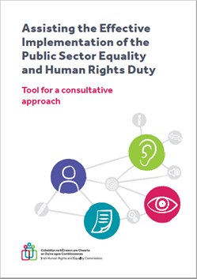
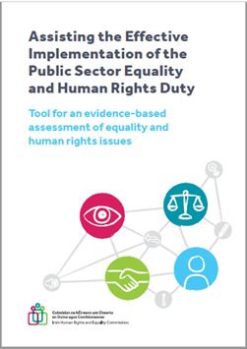

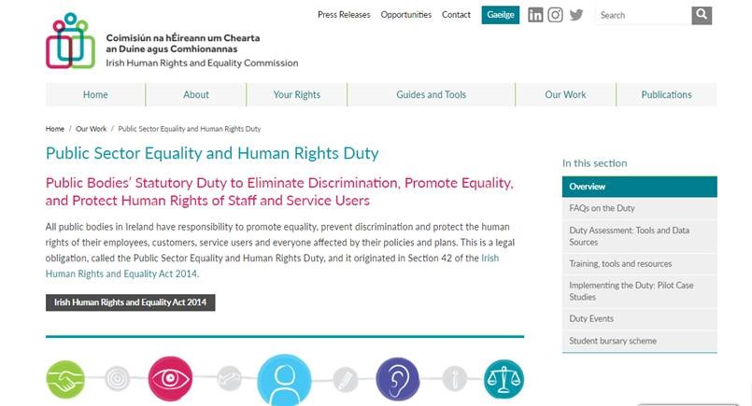

Supporting Implementation: PSD Guidance

Slide 22
Resources
Guidance for Public Bodies Implementing the Public Sector Equality and Human Rights Duty (2019) https://www.ihrec.ie/app/uploads/2019/03/IHREC_Public_Sector_Duty_Final_Eng_WEB.pdf
Animation Implementing the Public Sector Equality and Human Rights Duty (3 mins) (2020) https://vimeo.com/455511669
Tool: Assisting the Effective Implementation of the Public Sector Equality and Human Rights Duty: Tool for an evidence-based assessment of equality and human rights issues (2020) https://www.ihrec.ie/our-work/public-sector-duty/training-tools-and-resources/
Tool: Assisting the Effective Implementation of the Public Sector Equality and Human Rights Duty: Tool for a consultative approach (2020) https://www.ihrec.ie/our-work/public-sector-duty/training-tools-and-resources/
Guidance Note on COVID-19 and the Public Sector Equality and Human Rights Duty (2020) https://www.ihrec.ie/app/uploads/2020/09/Guidance-Note-on-COVID-19-and-the-Public-Sector-Equality-and-Human-Right-Duty.pdf
Website More information, tools, resources and guidance for public bodes available at https://www.ihrec.ie/our-work/public-sector-duty/
Animation Know Your Rights: A Guide to the Equal Status Acts 1m27s https://vimeo.com/359552263
Animation A Guide to the Employment Equality Acts 3m27s https://vimeo.com/384537698

Slide 23

Key Messages
Statutory obligation since 1 November 2014
Senior Level Commitment, Leadership, and Strategy
Align with strategic planning process/cycles (ongoing)
Vision and Values – Human Rights and Equality at their heart
Duty applies to -Staff and Service Users - daily work, across all functions - Translate Duty to everyday practice, a culture of respect for human rights and equality
Evidence based approach: Importance of Data, participation - Mechanisms for listening to and understanding diverse communities and groups,
Implementation structure to drive the Duty
Build on structures and initiatives already in place
Coherent framework for progressing actions relating to equality and human rights under national policies, strategies

Slide 24
Implementing the Public Sector
Equality and Human Rights Duty

